Slide 1
Machine Learning
Sandeep Singh

Slide 2

Artificial Intelligence Common Use cases
Artificial intelligence (AI) is the science of making things smart. Can be defined as
‘Human intelligence exhibited by machines.’
A broad term for getting computers to perform human tasks. The scope of AI is disputed and constantly changing over time.
Object recognition.
Speech recognition/ Sound detection.
Where are we today?
Systems implemented today are a form of narrow AI. A system that can do one or few defined things (better than humans). Like recognizing objects/gestures we trained it to learn

Slide 3
Machine Learning | ML learns from data provided
‘An approach to achieve AI through systems that can learn from experience to find patterns in a set of data.’
ML involves teaching a computer to recognize patterns by example, rather than programming it with specific rules. These patterns can be found within data. In other words, ML is about creating algorithms (or set of rules) that learn complex functions (or patterns) from data and make predictions on it – a form of “narrow AI”
ML is all about predicting stuff essentially. It is intelligent because:
It takes some data (to train the system)
Learns patterns from this data.
Classifies/predicts new data it has not seen before

Slide 4
Machine Learning Use case
Machine Learning may be used to find the profiles of customers of car insurance most likely to purchase home insurance from the same provider. This information has business value since it can help to improve the targeting of cross selling campaigns.
Name | Occupation | Age | Marital Status | No. Of Children | Car insurance | Home insurance
Arjun | Officer | 50 | Y | 2 | Y | Y
Sanju | Teacher | 45 | Y | 2 | Y | Y
Tom | Pilot | 33 | N | 0 | Y | N
Tim | Investor | 26 | N | 0 | Y | N
Sonia | Banker | 54 | Y | 4 | Y | N
Training Data
Building Model
Testing
Leo | Banker | 45 | Y | 3 | Y | ?

Slide 5
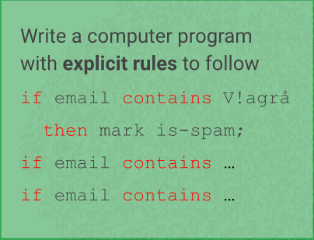
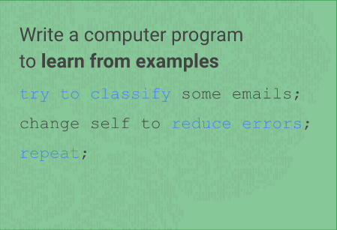
Comp Program with explicit rules | Computer program to learn from examples

Slide 6
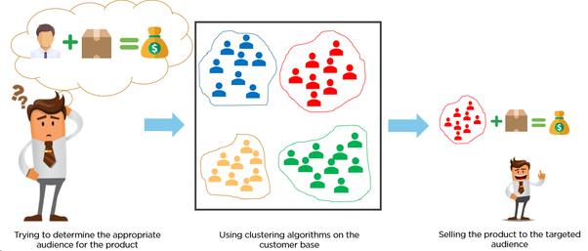
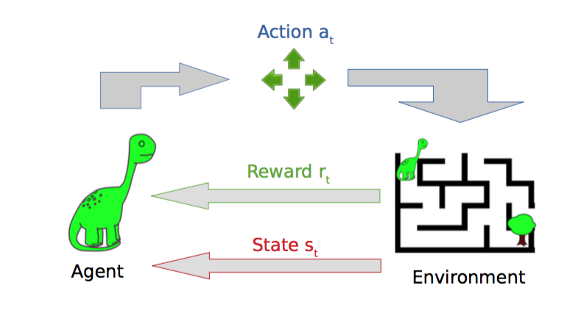
Machine Learning Types
Supervised ML: ‘We know what the output should be’
Unsupervised: ‘We DON’T know what the output should be’
Example : Customer clustering, Carrefour
Classification
o/p
Yes/No
Regression
o/p
Ex: Sales of Co.
Forecasting
o/p
Ex: Stocks price
Reinforcement Learning: ‘User specifies if output is good or bad’

Slide 7
ML in Daily life. Ever noticed ?
You emails automatically gets classified to ‘Primary’, ‘Promotions’ and ‘Spam’. What kind of learning is this ?
To predict the revenue generated by a company. What kind of learning is this ?
I bought milk from carrefour last week. Yesterday I received a text from carrefour saying there is buy 1 get 1 offer on Milk. What did carrefour do here?
Open your WhatsApp. Just type ‘hi’. Do you see some words suggestion by WhatsApp ? Is it same for all of you ? What kind of learning is this ? Text Prediction
**CAN YOU THINK OF SOME MORE EXAMPLES?**

Slide 8
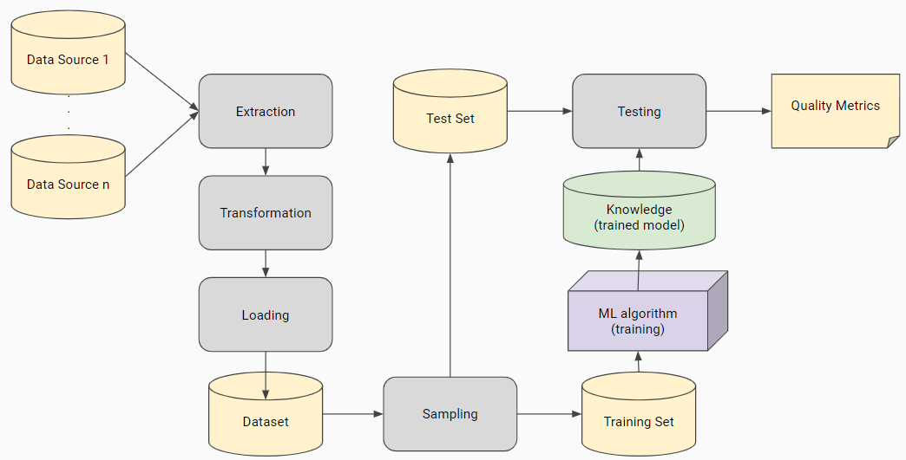
Machine Learning Work Flow

Slide 9
Machine Learning Work Flow
Extraction
Transforming
Loading
Can be from different Data sources.
Conversion
Remove outliers
Rounding
Scaling/Standardization
Dummy variables/One hot encoding
Factor Analysis
Sampling
Train-Test Split
Cross Validation
Train-Validation-Test split

Slide 10
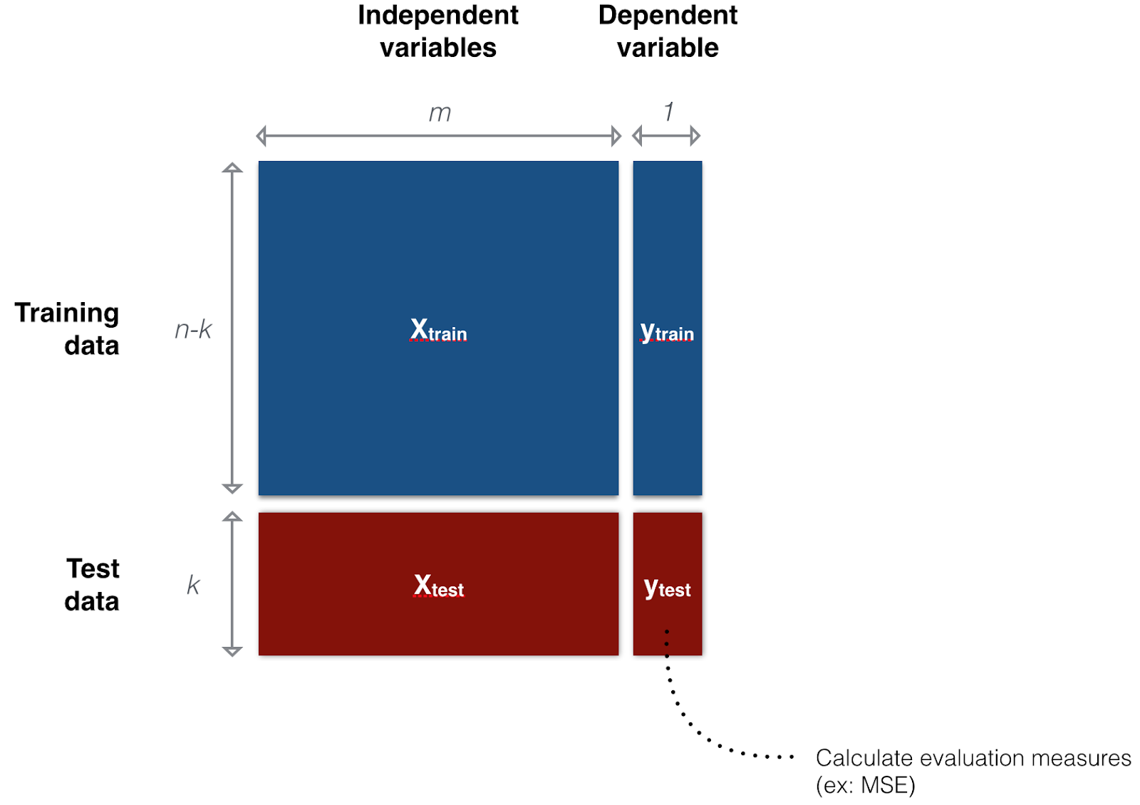
Machine Learning Work Flow – Train Test Split

Slide 11
Split Types
Train-Validation-Test Split
Train Test Split - Cross Validation-
20%
Randomly partition the dataset in n bins
For every bin ( b):
Train with the remaining ( n-1) bins.
Test with b and obtain quality metric.
Output the average of the n quality metrics obtained.
70%
20%
Train
20%
20%
30%
20%
Test
Randomly partition the dataset in 3 disjoint subsets (training, validation, and test sets).
Initialize the hyperparameters
Train with the train set.
Evaluate on validation set.
Update best performing hyperparameters.
Recompute/modify the hyperparameters while maximum number of iterations not reached.
Using the best performing hyperparameters, compute the definitive quality metric on the test set
60%
20%
20%

Slide 12
Building Models – Big Picture
Linear Regression,
Logistic Regression,
SVM,
Naïve Bayes,
Decision Trees,
Random Forest
For Regression Problems: Linear, Decision Trees, Random Forests, SVM, KNN, Neural Nets
Classification Problems: Logistic, Decision Trees, Random Forests, SVM, KNN, Neural Nets
TIME SERIES FORECASTING- When you want to predict with respect to time. ARMA, ARIMA, SARIMAX
Supervised
Data Extraction
(Sql, Web scrapping, csv etc)
Data Cleaning
(null values, outliers etc)
Feature Engineering
(Dummies, RFE etc)
Building Models
Clustering,
PCA,
K means
Unsupervised

Slide 13
Feature Extraction and Engineering

Slide 14
Stats Models vs SKLearn for Linear Regression

Slide 15
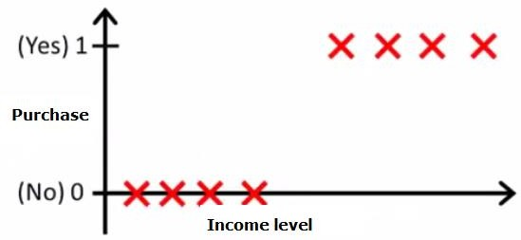
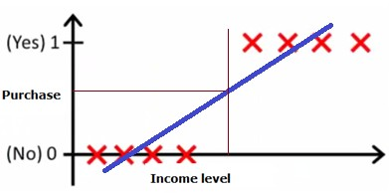
Logistic Regression Model
Y axis(Dependent Variable): Will the customer purchase the product or not?
Let’s apply Linear regression to predict our dependent variable

Slide 16
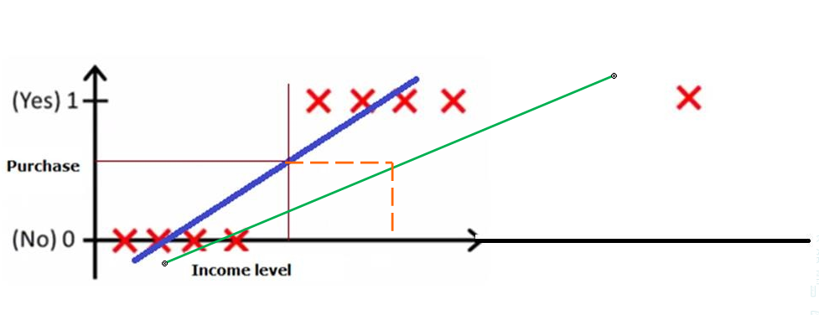
It could fail
Adding a new guy with high income should not change your conclusion on where you draw the threshold line. But in this case, it’s not true. Adding him will definitely change your best fit line.
And that best fit line will move the threshold to some other point.
This is the problem with linear regression, it keeps on changing the best fit line.

Slide 17
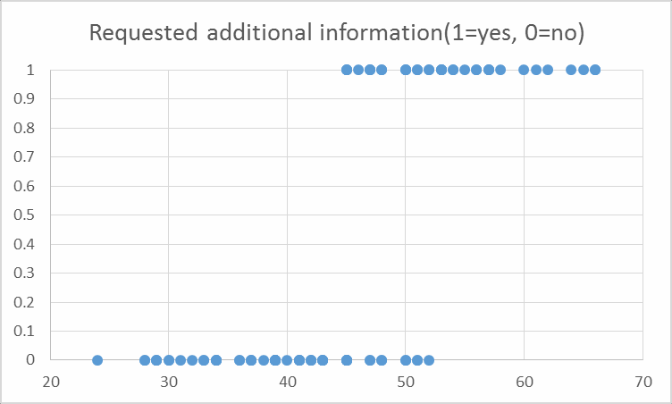


How and why Logistic Model Works ?
This is a logistic model.
P is the probability that a customer will purchase product or not.

Slide 18
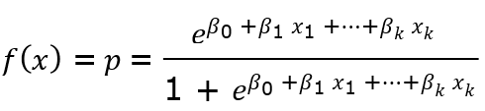
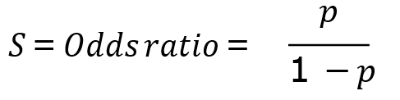
How and why Logistic Model Works ?
Odds ratio is obtained by the probability of an event occurring divided by probability of an event that will not occur.
Logistic Model can be transformed into odds ratio:

Slide 19
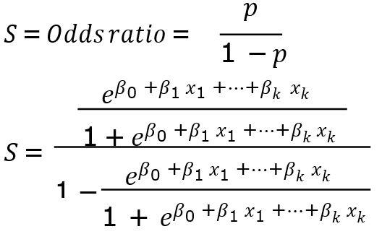
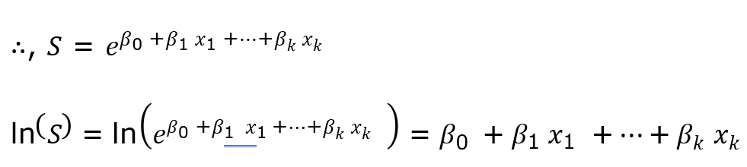
How and why Logistic Model Works ?

Slide 20
K Nearest Neighbours

Slide 21

When to Use KNN Algorithm?
KNN can be used for both classification and regression predictive problems. However, it is more widely used in classification problems in the industry.
DT

Slide 22
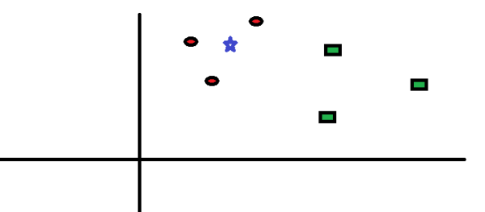
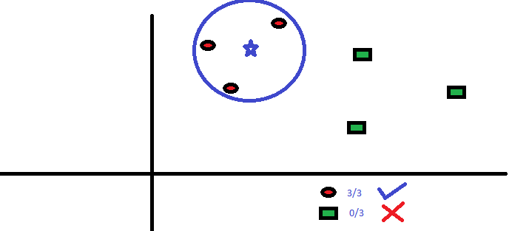
How does it work?

Slide 23
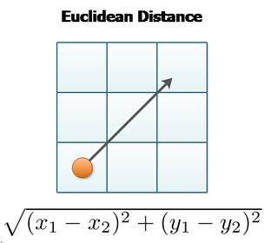
How does the Algorithm Work?
Age | Income | Loan Approval
25 | 12000 | N
30 | 36000 | Y
26 | 40000 | Y
56 | 50000 | Y
70 | 2000 | N
If Age = 28, Income = 15000 then Loan Approval = ?
i) Sqrt[(28-25)^ + (15000-1200)^] = 1.5
ii) Sqrt[(28-30)^ + (15000-36000)^] = 2.1
iii) Sqrt[(28-26)^ + (15000-40000)^] = 3.6
iv) Sqrt[(28-56)^ + (15000-5000)^] = 1.6
v) Sqrt[(28-70)^ + (15000-2000)^] = 1.7
Given k =3, Algo will select i), iv) and v). Since there are the top three nearest.
i)= ‘N’, iv) = ‘Y’ and v) ‘N’.
Maximum votes are for ‘N’. Hence output is ‘N’

Slide 24
Pseudo code of KNN Algorithm?
Load the data
Initialise the value of k
For getting the predicted class, iterate from 1 to total number of training data points
Calculate the distance between test data and each row of training data. Here we will use Euclidean distance as our distance metric since it’s the most popular method. The other metrics that can be used are Chebyshev, cosine, etc.
Sort the calculated distances in ascending order based on distance values
Get top k rows from the sorted array
Get the most frequent class of these rows
Return the predicted class

Slide 25
Let’s kill it in Python

Slide 26
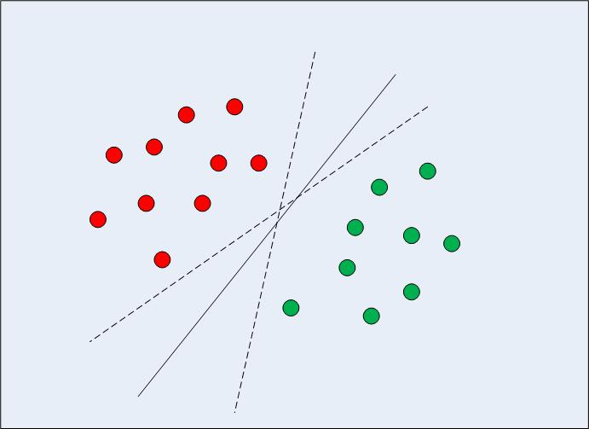
SVM Algorithm
Tries to find a boundary that divides the data in such a way that the misclassification error can be minimized.
When to use it?
Can be used for both classification and regression problems. However it is mostly used in case of classification.

Slide 27
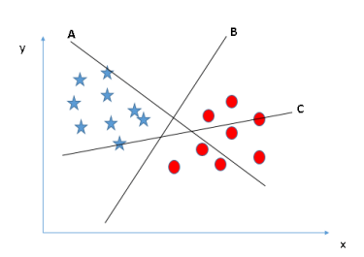
SVM Algorithm: How does it work?
Identify the right hyper-plane (Scenario-1): Here, we have three hyper-planes (A, B and C). Now, identify the right hyper-plane to classify star and circle

Slide 28
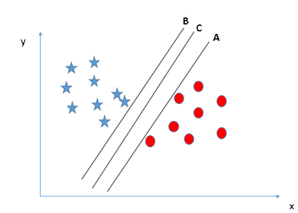
SVM Algorithm: How does it work?
Identify the right hyper-plane (Scenario-2): Here, we have three hyper-planes (A, B and C) and all are segregating the classes well. Now, How can we identify the right hyper-plane?

Slide 29
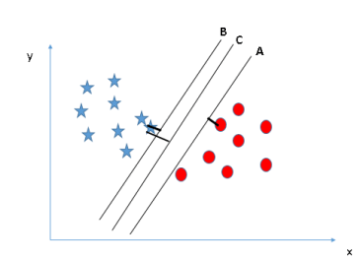
SVM Algorithm: How does it work?
Maximizing the distances between nearest data point (either class) and hyper-plane will help us to decide the right hyper-plane. This distance is called as Margin

Slide 30
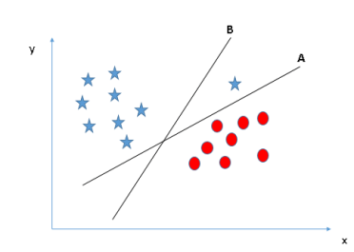
SVM Algorithm: How does it work?
Identify the right hyper-plane (Scenario-3):Hint: Use the rules as discussed in previous section to identify the right hyper-plane

Slide 31
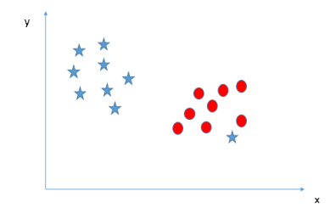
SVM Algorithm: How does it work?
Can we classify two classes (Scenario-4)?: Below, I am unable to segregate the two classes using a straight line, as one of star lies in the territory of other(circle) class as an outlier.

Slide 32
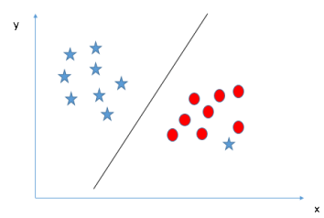
SVM Algorithm: How does it work?
SVM has a feature to ignore outliers and find the hyper-plane that has maximum margin. Hence, we can say, SVM is robust to outliers.

Slide 33
SVM Algorithm
There is complex mathematics involved behind finding the support vectors, calculating the margin between decision boundary and the support vectors and maximizing this margin.
Here we are not going into the detail of the mathematics, we will rather see how SVM and Kernel SVM are implemented via the Python Scikit-Learn library.

Slide 34
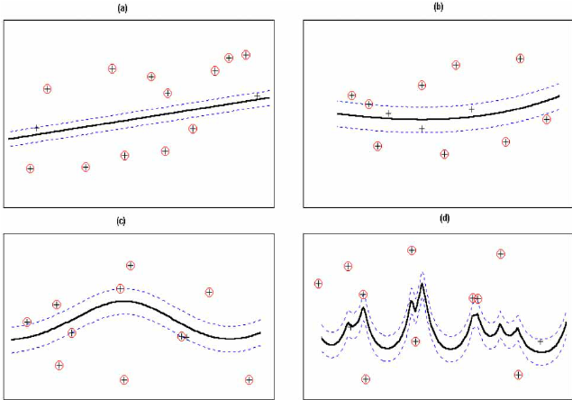
SVM Algorithm with different Kernels

Slide 35
Conditional Probability

Slide 36
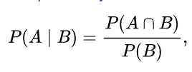
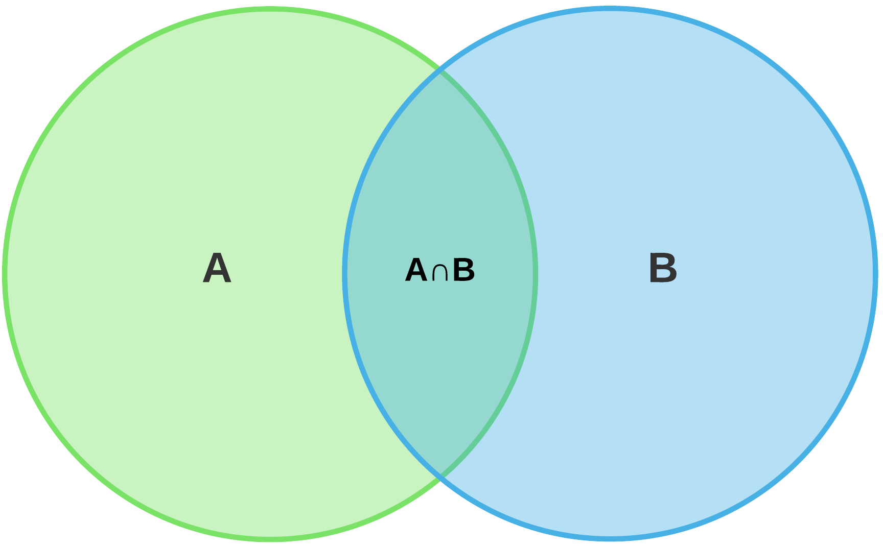
Conditional Probability
Probability of A and B
Finding the probability of event A given that event B has already occurred
Probability of A and B
30 Students like apples
P(A|B) = ?
40 Students like Oranges
20 students like both

Slide 37
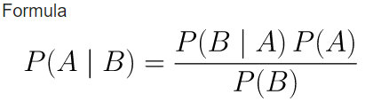
Bayes Theorem
Likelihood
Prior
A – Hypothesis
B – Data/evidence
Find the Probability of
Hypothesis given that we have
Observed the data/evidence
(POSTERIOR Probability)
Marginal
Example:
P(King|Face) = P(Face|King) * P(King) / P(Face)
= 1 * (4/52) / (12/52)
= 1/3

Slide 38
PCA (Principal Component Analysis)
To Overcome the problem of outliers. It tries to reduce overfitting problems.
Dimensionality reduction technique
We had the overfitting problem because we trained the model with more no. of attributes. So, using PCA we can reduce the dimensions.
No. of PCA can be less than or equal to given attributes.
For example: If have generated PC1, PC2,… which component to choose.
PC1 should be given high priority.
Orthogonal Property: Which means PC1 and PC2 should follow orthogonal property. They should be independent to each other. All your principal components should follow orthogonal property.

Slide 39
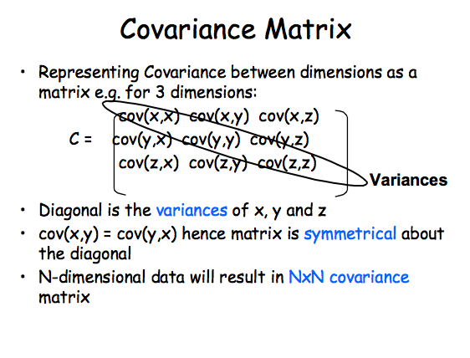

Mathematics behind PCA
X | Y
2.5 | 2.4
0.5 | 0.7
2.2 | 2.9
1.9 | 2.2
3.1 | 3.0
2.3 | 2.7
2 | 1.6
1 | 1.1
1.5 | 1.6
1.1 | 0.9
Xmean = 1.81
Ymean = 1.91
0.6165
0.6154
C =
0.6154
0.7165

Slide 40
Mathematics behind PCA
Take the mean of X and Y
Calculate covariance and generate covariance matrix
Get eigen value and eigen vectors
| C – λI| = 0
0.6165
0.6154
1
0
–
λ
= 0
0.6154
0.7165
0
1

